Slide 1

Pregnancy outcomes related with the level of AMH in unexplained repeat pregnancy loss women under 35 years old
Seung Heup Nam, Joon Cheol PARK
Depart. Obstet Gynecol
Keimyung University, Daegu, Korea

Slide 2

Introduction
Genetic cause, anatomic cause, and antiphospholipid syndrome are the only undisputed causes of RPL.
Approximately 50% of cases of RPL are classified as unexplained. (immunologic and thrombogenic)
Advanced maternal age is related with miscarriages, which is predisposed to a greater risk of fetal aneuploidy.

Slide 3

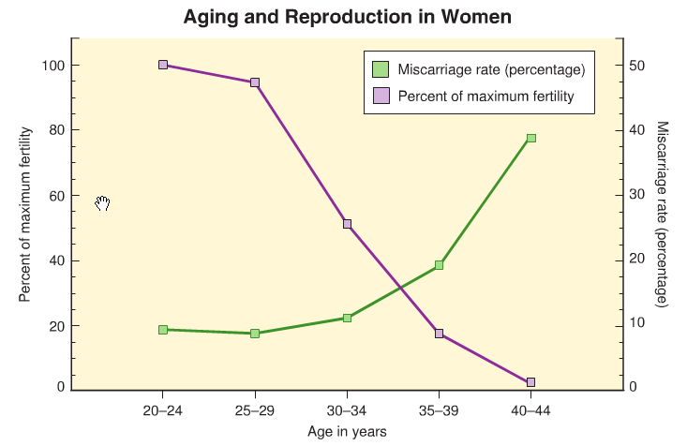
Introduction
It has been proposed biological ovarian age is more important than chronologic age.
Down syndrome is increased in women with elevated serum levels of FSH, regardless of age and regardless of whether the low ovarian reserve came about natually or resulted from ovarian surgery.
Speroff 8th ed

Slide 4
Introduction
AMH is well correlated with diminished ovarian reserve, readily used for predicting the oocytes' quantity in IVF cycle.
Some studies regarding the relationship between AMH and miscarriage have been tried. However, the evidences are still lack, especially in young women.
Notes:
Low or high AMH levels, compared with normal AMH, were not associated with clinical loss. Zarek et al. Fertil Steril 2016

Slide 5
Introduction
The aim of this study was to evaluate whether antimullerian hormone was associated with pregnancy loss in young unexplained repeat pregnancy loss (RPL) women.

Slide 6
Material and methods
RPL defined as two or more miscarriage
Four hundred fifty nine women consecutively registered from January 2014 through December 2017.
Unexplained RPL under 35 years old were enrolled
after excluding other etiologic cause
: genetic, anatomic, endocrinological cause
after excluding women over 35 years old
103 women were enrolled for this study

Slide 7
Material and methods
To compare other etiological causes, Natural killer cell proportion, protein C activity, protein S activity, antithrombin III, homocystein and plasminogen activator inhibitor-1 (PAI-1) were evaluated.
AMH levels were defined as low (< 1.0 ng/ml), normal (1.0 - 3.5 ng/ml) and high (>3.5 ng/ml).
Pregnancy rate and miscarriage rate were compared among each groups.

Slide 8
Results
Demographic data of enrolled women
mean age : 31.56 ± 2.66 years old (24 – 35)
mean parity : 0.15 ± 0.38 (0 - 2)
mean miscarriage was 2.52 ± 1.02 (2 – 7)
 | AMH<1.0 (n=6) | AMH 1.0-3.5 (n=33) | AMH>3.5 (n=64) | p-vaue
Age | 34.00±1.09 | 32.24±1.71 | 30.98±2.96 | 0.05
Parity | 0.17±0.41 | 0.15±0.44 | 0.14±0.35 | 0.96
SA | 2.50±0.84 | 2.79±1.39 | 2.39±0.77 | 0.18
Notes:
Mean age of enrolled women was 35.20±4.79 years-old, mean parity was 0.13±0.45, and mean number of miscarriage was 0.81±1.49. Sexual transmitted infections were detected in 92 women (67.62%),

Slide 9
Results
Etiologic evaluation of each groups
 | AMH<1.0 | AMH 1.0-3.5 | AMH>3.5 | p-vaue
AMH | 0.79±0.25 | 2.14±0.75 | 8.04±3.87 | 0.00
TSH | 2.21±1.49 | 2.64±1.15 | 2.52±2.02 | 0.36
Prolactin | 1.0.19±3.95 | 11.73±6.32 | 9.54±4.38 | 0.35
b-Glc | 95.83±4.44 | 91.15±8.62 | 92.37±9.90 | 0.20
Fasting insulin | 7.45±3.39 | 12.39±12.29 | 8.61±5.53 | 0.73
PAI-1 | 14.19±15.33 | 29.98±26.13 | 25.68±18.22 | 0.17
NK | 14.16±15.33 | 29.98±26.13 | 25.68±18.22 | 0.64
Homocystein | 7.85±3.01 | 8.89±1.99 | 9.07±2.01 | 0.15
Prot C | 111.17±13.53 | 107.19±18.24 | 107.04±18.57 | 0.82
Prot S | 91.55±18.31 | 77.16±13.19 | 77.69±22.71 | 0.25
Antithrombin III | 106.17±10.83 | 100.52±9.48 | 103.05±11.49 | 0.42

Slide 10
Results
Pregnancy outcomes
 | AMH<1.0 | AMH 1.0-3.5 | AMH>3.5 | p-vaue
CPR | 3/6 (50.0%) | 21/33 (63.6%) | 37/64 (57.8%) | 0.77
Ongoing Preg. rate | 1/6 (16.7%) | 17/33 (51.5%) | 27/64 (42.2%) | 0.26
Miscarriage rate | 2/3 (66.7%) | 4/21 (19.0%) | 10/37 (27.0%) | 0.21
Gestational weeks | 40.6 | 38.04±3.22 | 36.18±3.65 | 0.06

Slide 11
Conclusion
AMH values might not be associated with repeat pregnancy loss in unexplained RPL women under 35 years old.
The limitation of this study was the small number of enrolled women especially in low AMH group. Further large scale study is needed.

Slide 12
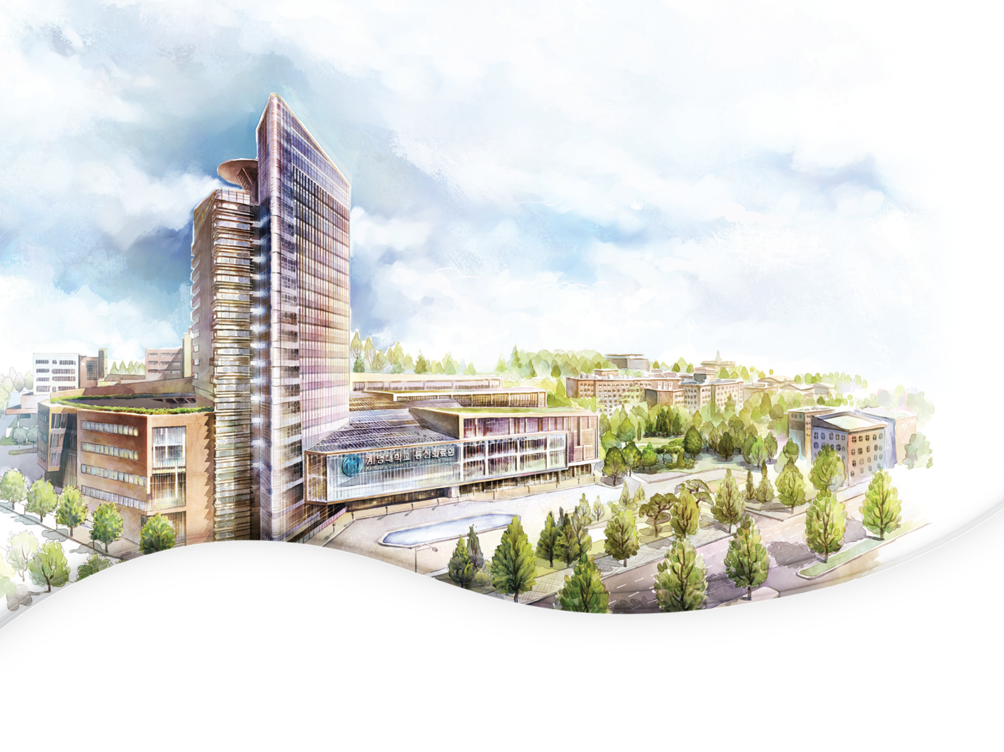


경청해주셔서 감사합니다.

